Slide 1
MATHEMATICS
CALCULUS

Slide 2
Applications of Derivatives

Slide 3
Rolle’s Theorem and
Lagrange’s Mean Value Theorem

Slide 4
Rolle’s Theorem

Slide 5
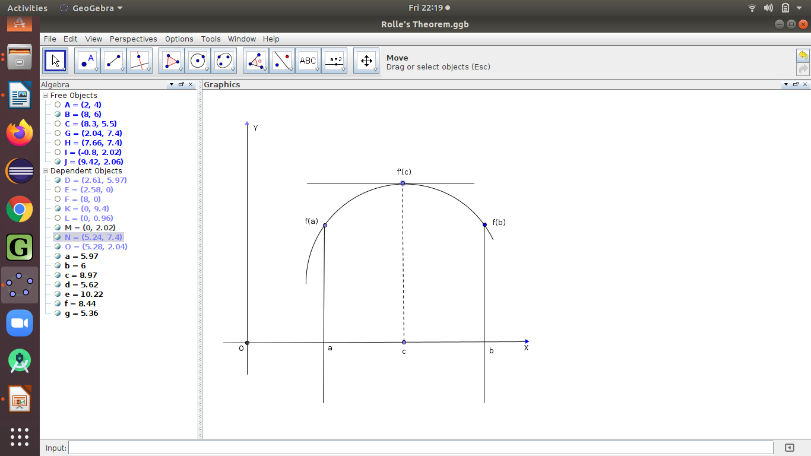
Rolle’s Theorem or Rolle’s Lemma
If a real valued function is
continuous on a closed interval
, differentiable on the open
interval and
then there exists at least one
in the open interval
such that .

Slide 6
Examples
(1) Check whether conditions of Rolle’s theorem are
satisfied by
Solution : Given,
is a polynomial which is continuous on
and it is differentiable on
Let

Slide 7
Hence conditions of Rolle’s theorem are satisfied .

Slide 8
(2) Check whether conditions of Rolle’s theorem are satisfied by ,
Solution : Given,

Slide 9
Solution : Given,

Slide 10
All the conditions of Rolle’s theorem are satisfied.
To get the value of ,

Slide 12
Solution : Given that,

Slide 13
(5) Verify the Rolle’s theorem for the function
Solution : Given,

Slide 15
All the conditions of Rolle’s theorem are satisfied. To get the
value of we should have for some

Slide 17
Lagrange’s Mean Value Theorem

Slide 18
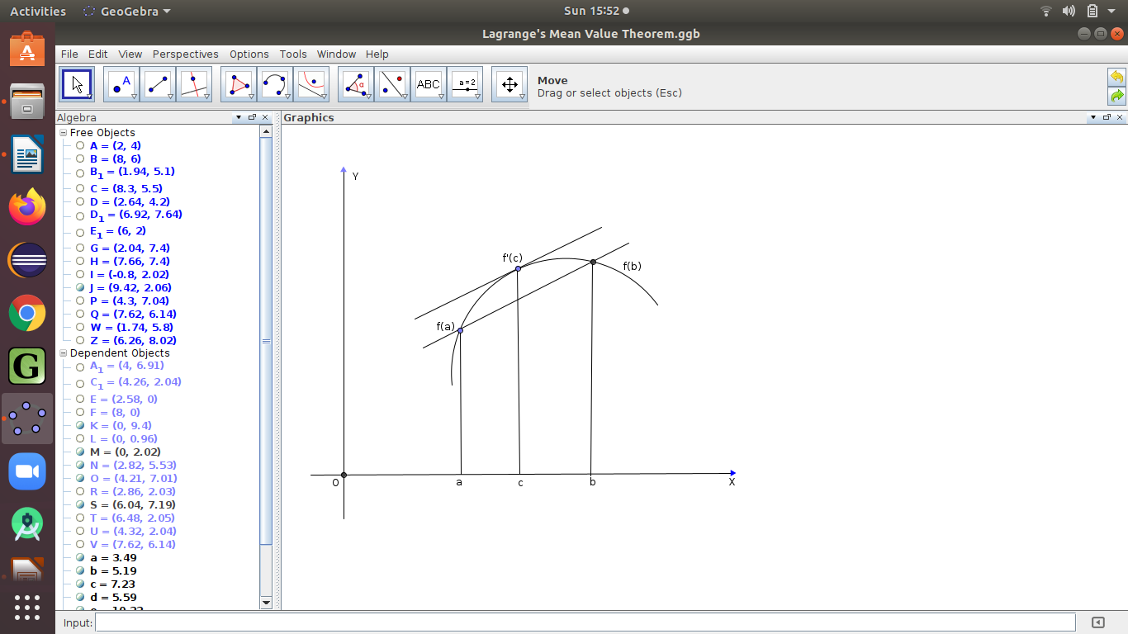
Lagrange’s Mean Value Theorem
If a real valued function is continuous on a closed
interval , differentiable on the
open interval then there
exists at least one in the open
interval such that
slope of tangent at = slope of chord PQ
Q
P

Slide 19
Solution : Given that

Slide 21
Solution : Given that

Slide 23
##### DONE #####

Slide 24
T H A N K Y O U

